Slide 1

Life Expectancy and GDP analysis presentation
From : Prithivi Sharma

Slide 2
Introduction
Research Question : Can life expectancy readings be indicated through an analysis of a country’s GDP?
Number of Nations : 6
Names of Nations : USA, China, Zimbabwe, Germany, Mexico, Chile
Years Analysed : 2000- 2015

Slide 3
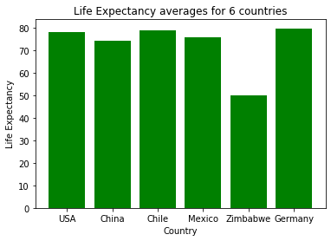
Life Expectancy analysis: Average Life Expectancy of the 6 nations
The average life expectancy readings of almost all of the countries are very similar unlike Zimbabwe.

Slide 4
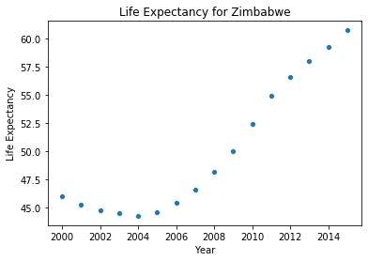
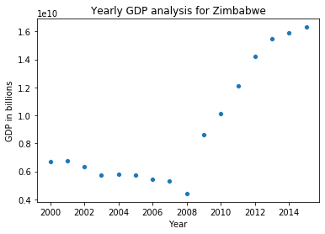
Zimbabwe Life Expectancy and GDP readings
Although containing a low average of life expectancy, there is a trend of increase in each reading for Zimbabwe.

Slide 5
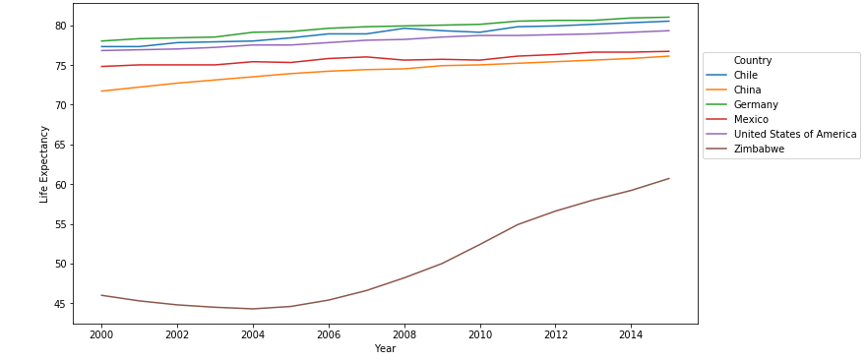
Life Expectancy analysis : Life Expectancy readings per year for each nation
The life expectancy readings of these countries show a common trend of amongst all countries over time.
The country that has kept an increased level of life expectancy has been USA.

Slide 6
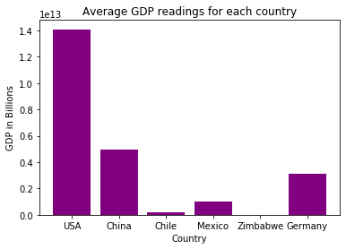
GDP analysis: Average GDP of the 6 nations
The average GDP readings don’t indicate GDP values being similar amongst the countries.

Slide 7
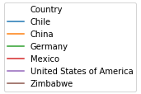
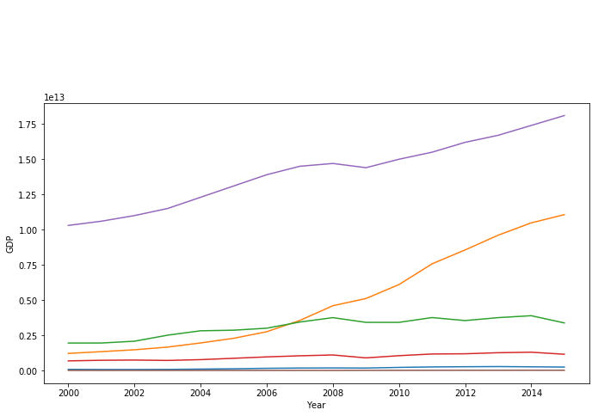
GDP analysis : GDP readings per year for each nation
The GDP readings of these countries do not show a trend of increase amongst all countries like their life expectancies.
The countries that have kept a steady increase in their GDP over time have been China and USA.

Slide 8
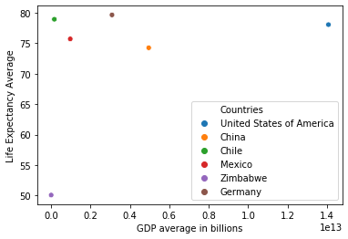
Data Analysis – Average Life Expectancy and GDP analysis correlation.
The country with the best average in both GDP and Life Expectancy is USA, showing that USA is the most developed in terms of an increased GPA level and life expectancy readings.

Slide 9
Conclusion
Life Expectancy readings of a country cannot be indicated through the analysis of a country’s GDP readings.
The countries with the best trends within both GDP and Life Expectancy: USA, China.
The countries with the worst trends within GDP and Life Expectancy: Chile, Zimbabwe.

